Slide 1
CS3205 – HCI in Software Development Norman’s Design Principles
Dr. Mark Floryan
Rice Hall 203
mrf8t@cs.virginia.edu
* From Norman’s Design of Everyday Things and our textbook.

Slide 2
Don Norman’s Design Principles
1. Visibility //similar to ones we have seen
2. Feedback //we have already seen this one
3. Affordance
4. Mapping
5. Constraint
6. Consistency // Already have seen this one

Slide 3
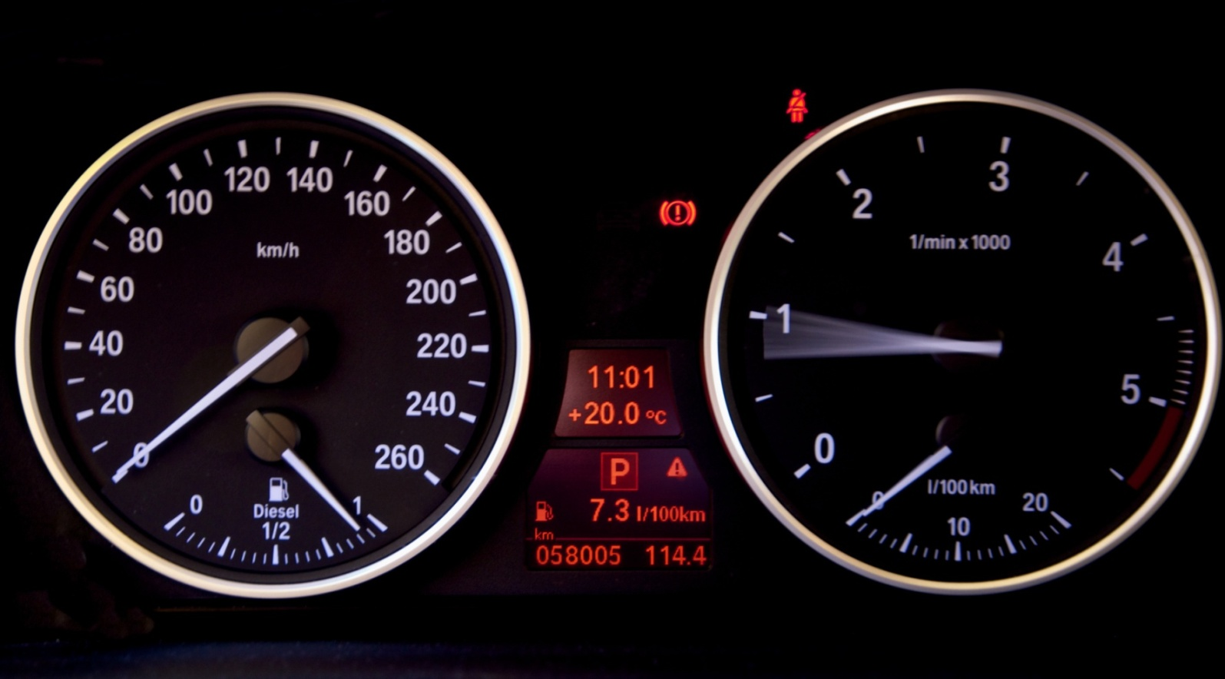
1. Visibility
Users should always be able to:
See the state of the device
See the possible set of actions

Slide 4
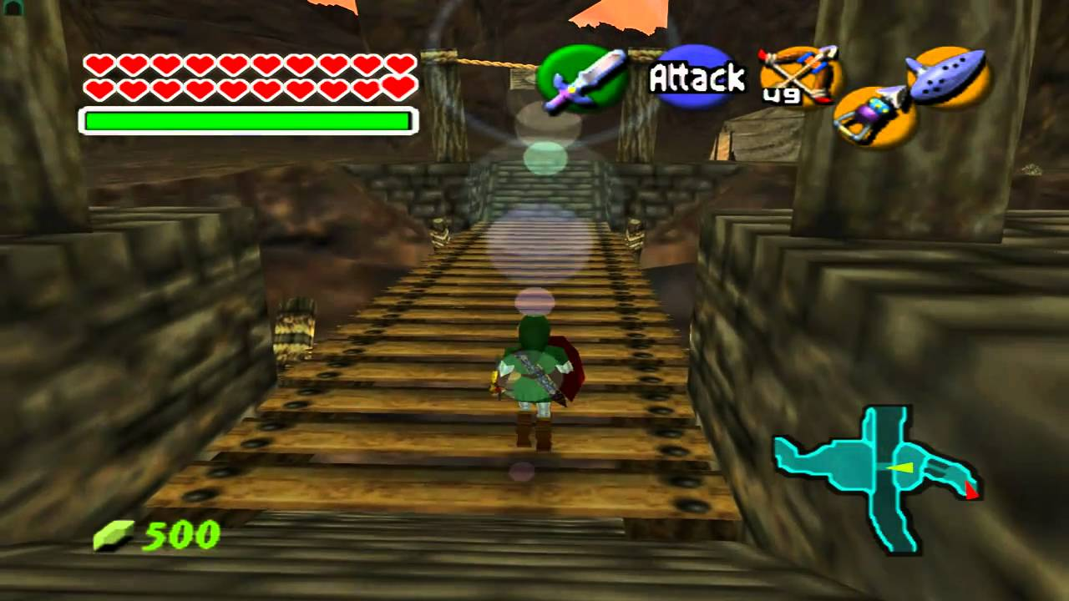
1. Visibility
Users should always be able to:
See the state of the device
See the possible set of actions

Slide 5

1. Visibility
Problems arise if we can’t see how to use something.
Auto faucets have invisible “active zone”

Slide 6
1. Visibility

Slide 7

1. Visibility

Slide 8
1. Visibility

Slide 9
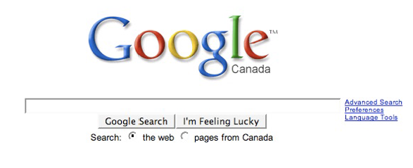
1. Visibility

Slide 10
2. Feedback
What is the system doing now?
What action has been performed?
How did the system interpret my action?

Slide 11
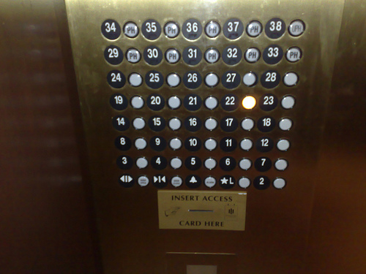
2. Feedback

Slide 12
2. Feedback
Letting you know the system is charging…
Why is this good feedback?

Slide 13
2. Feedback
Examples of feedback:
Links change colors when you mouse over them.
Sound effects when action taken.
Progress bars (we discussed this earlier)
Others?

Slide 14
3. Affordances / Signifiers
Coined by American psychologist J.J. Gibson in mid-1900’s
“The affordances of the environment are what it offers the animal, what it provides or furnishes, either for good or ill.”
Don Norman replaced this concept of objective affordances with that of “perceived affordances”

Slide 15
3. Affordances / Signifiers
Affordance – The set of actions a design affords are the actions that can be taken in the environment.
Perceived Affordance – Don Norman originally appropriated the term ‘perceived affordance’ to mean an affordance the user can see directly.
Signifier – Later, Norman replaced this with signifier, a visual or cultural clue as to the operation of a device.

Slide 16

3. Affordances / Signifiers

Slide 17
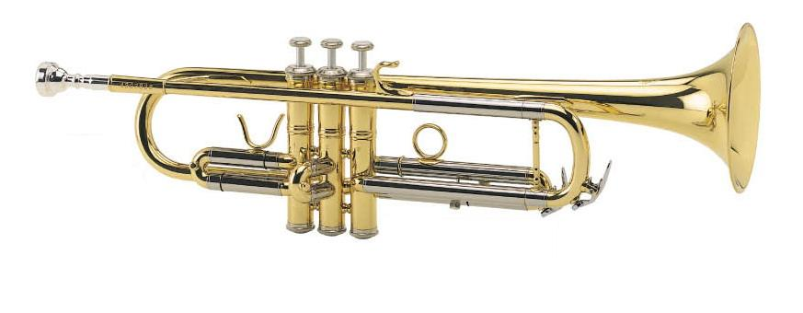
3. Affordances / Signifiers

Slide 18




3. Affordances / Signifiers

Slide 19
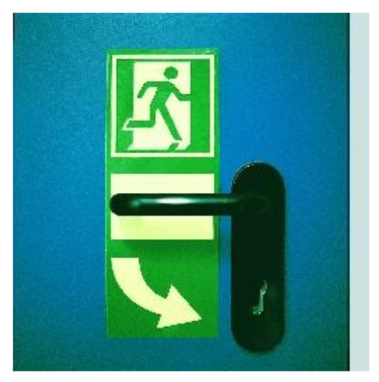
3. Affordances / Signifiers
Is this necessary?

Slide 20
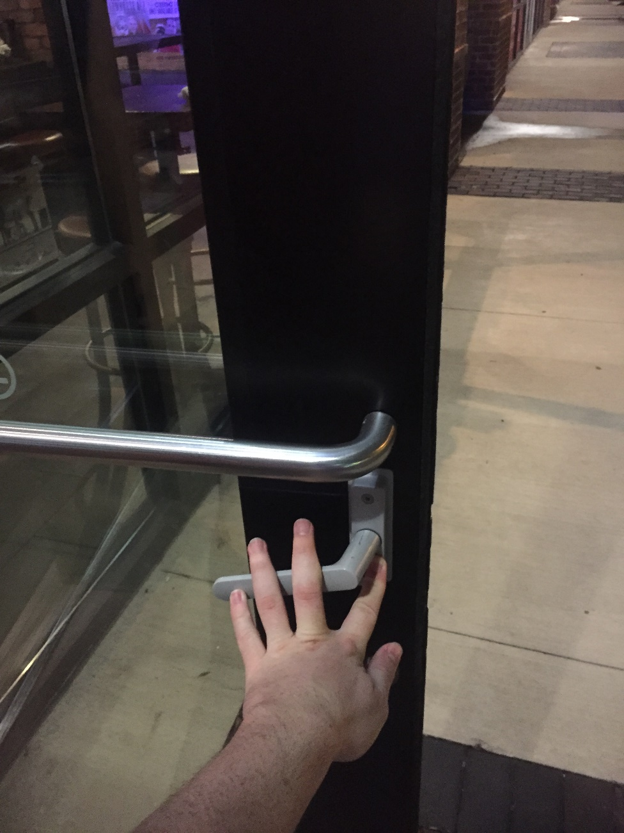
3. Affordances / Signifiers

Slide 21
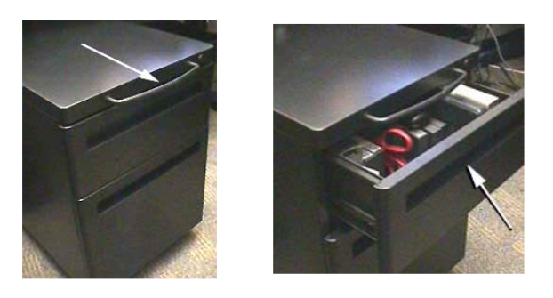
3. Affordances / Signifiers

Slide 22
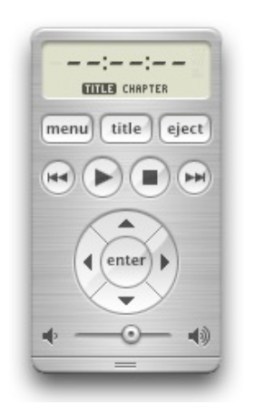
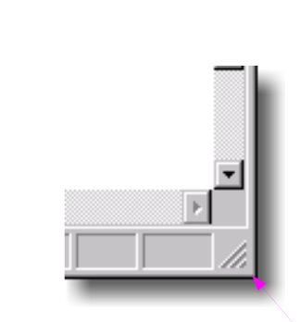
3. Affordances / Signifiers

Slide 23
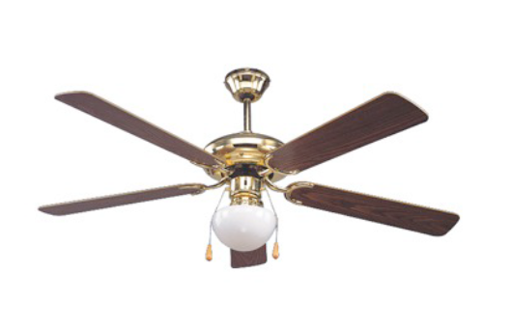
4. Mapping
Relationship of controls to their effects.

Slide 24
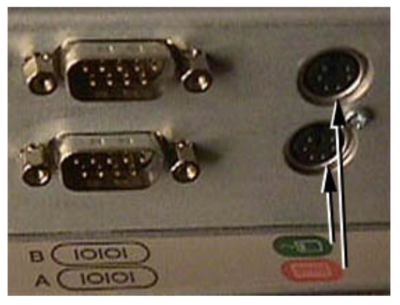
4. Mapping

Slide 25
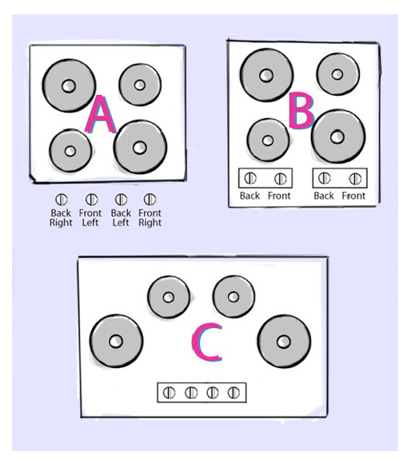
4. Mapping

Slide 26
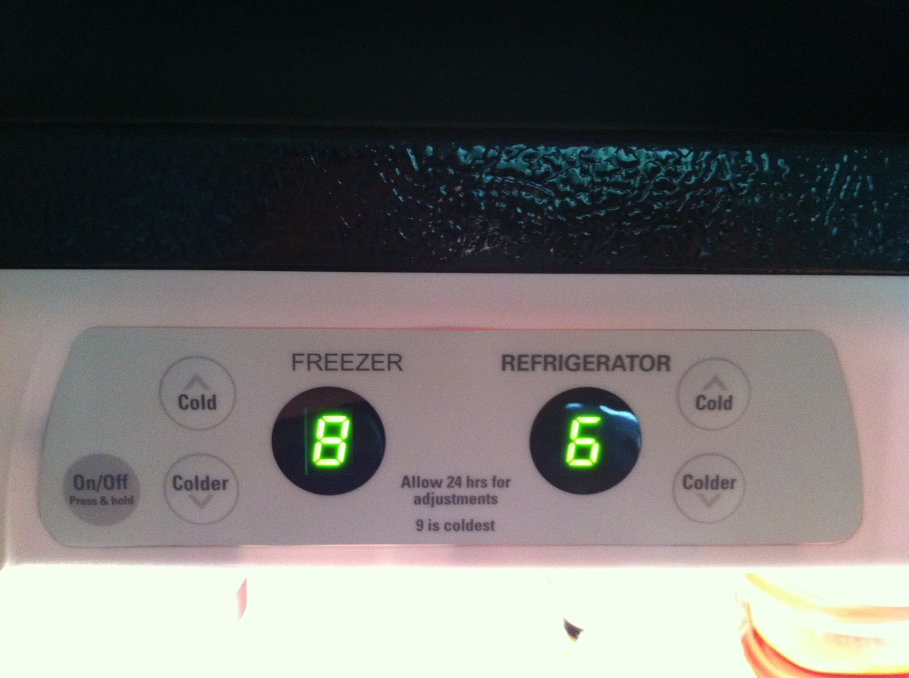
4. Mapping

Slide 27
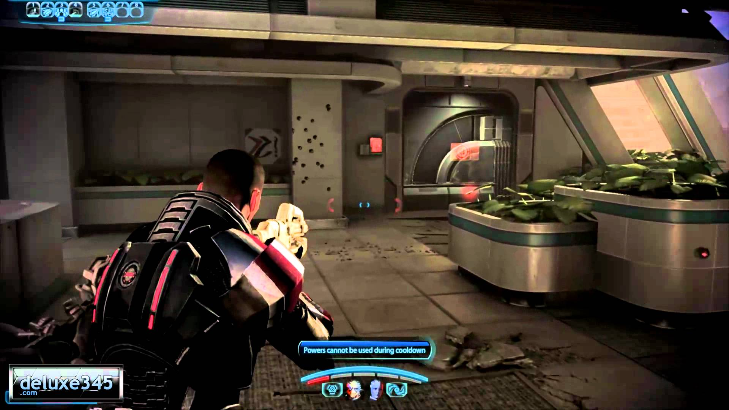
4. Mapping
What should pulling back on joystick do? Look up or look down?

Slide 28
4. Mapping

Slide 29
4. Mapping
The sign says:
“See that big red button? Yea? Don’t Press It!
If the door is locked when you try to open it, the motion sensor on the ceiling didn’t see you. To get the door unlock…
…If you press the button the alarm sounds, and nobody wants to hear that alarm.”

Slide 30
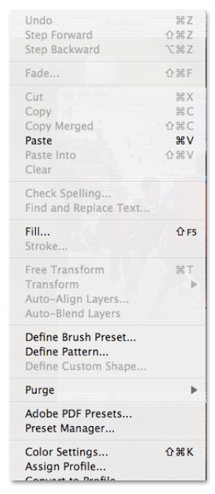
5. Constraint
Constrain the kinds of interactions that can take place. Helps reduce user’s memory load.

Slide 31
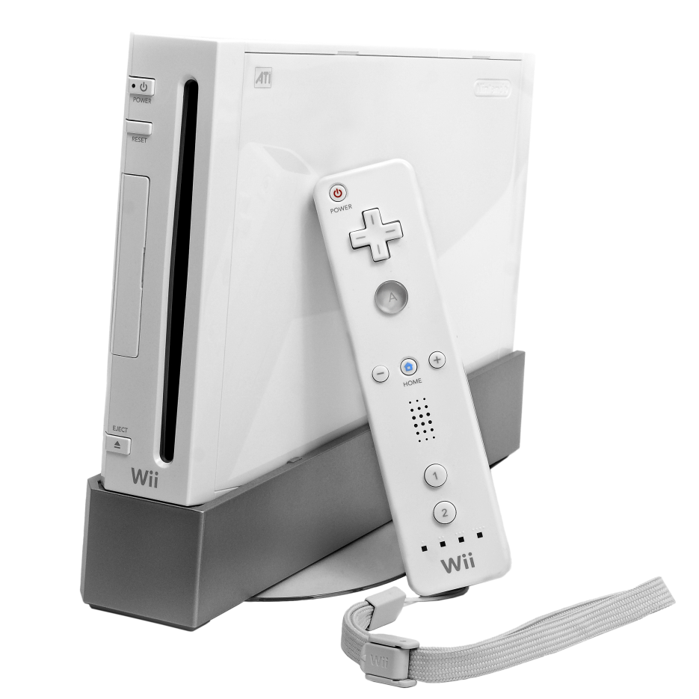
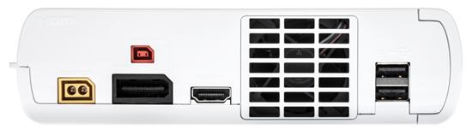
5. Constraint
Easy to setup the console because each cord only fits one slot.

Slide 32
6. Consistency
Already discussed in previous lecture, so won’t spend too much time here.
Four types of consistency (two new ones)
Aesthetic
Functional
Internal
External

Slide 33
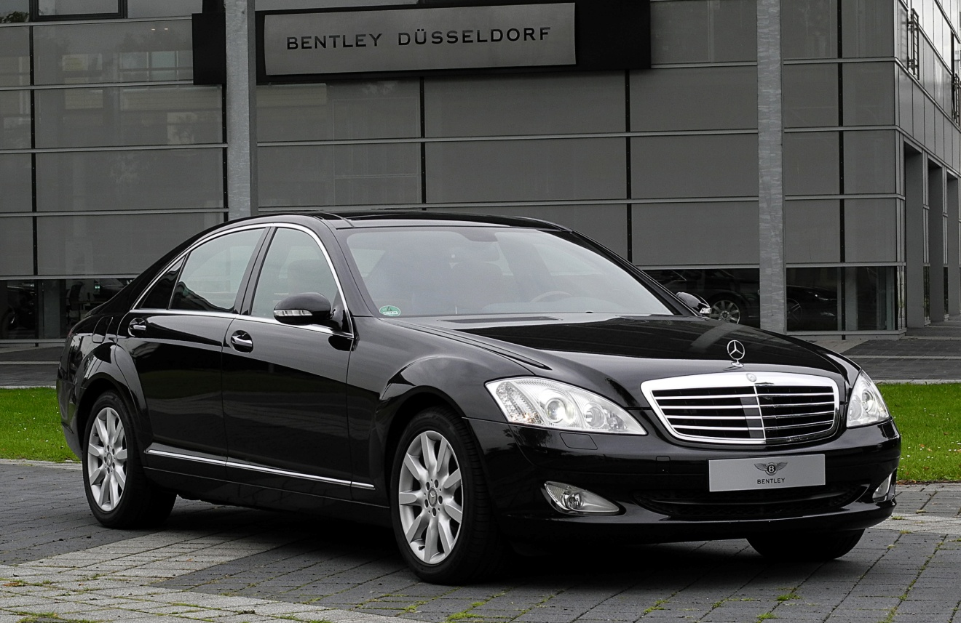
6. Consistency
Aesthetic Consistency:
Style and appearance is repeated.
Communicates membership and sets tone.

Slide 34
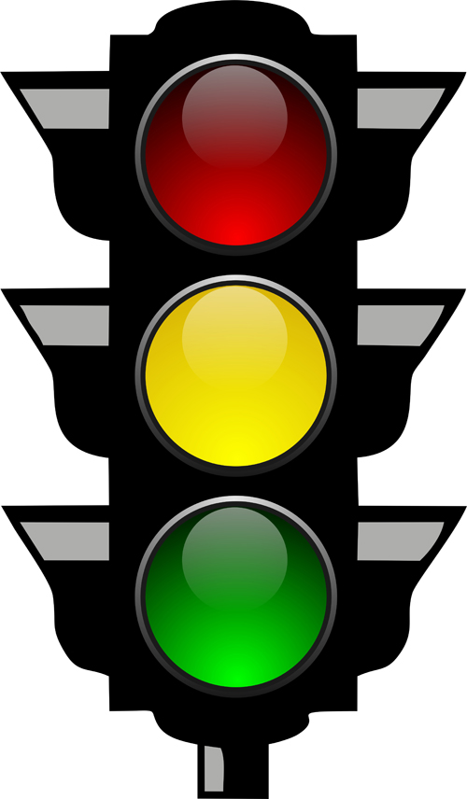
6. Consistency
Functional Consistency:
Consistent use of colors (colors always represent the same thing)
Consistent use of symbols to represent actions

Slide 35
6. Consistency
Internal Consistency:
Consistency within your application
External Consistency:
Consistency with other applications
You’ve already seen these.

Slide 36
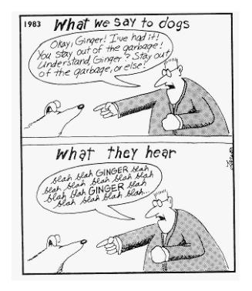
Bonus: People Hate Reading!

Slide 37
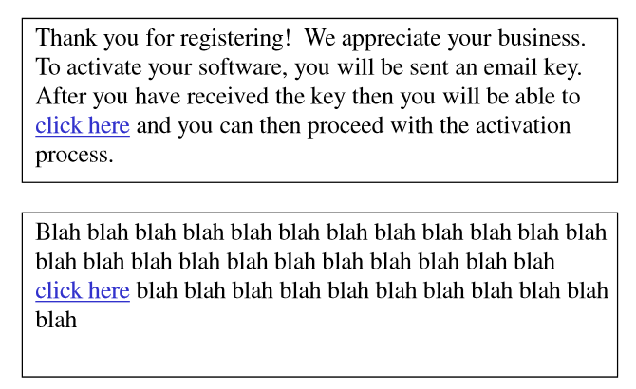
Bonus: People Hate Reading!

